Slide 1
Deep Learning in Wilderness
Daesoo Lee
NTNU
04/2024

Slide 2
Overview

Slide 3
Overview
Extension of FeedForward Network (FFN)
Why Convolutional Neural Network (CNN) for images only?
Goodbye Recurrent Neural Network (RNN) for sequence modeling
Active Study Fields in Deep Learning

Slide 4
Extension of FeedForward Network (FFN)

Slide 5
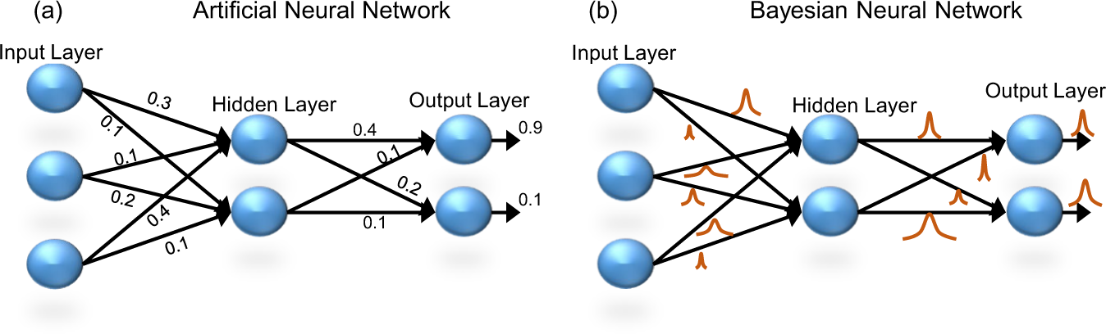
Extension of FeedForward Network (FFN)
FFN, are we confident with the prediction?
cat
dog

Slide 6
Extension of FeedForward Network (FFN)
Let’s admit that there’s uncertainty in the model

Slide 7
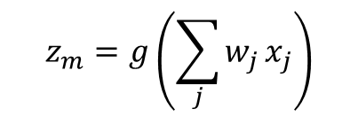
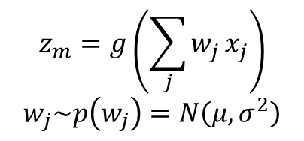
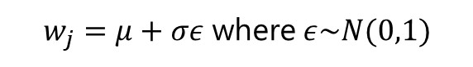



Extension of FeedForward Network (FFN)
$$z_{m}=g\left(\sum_{j}{w_{j}}x_{j}\right)$$
$$z_{m}=g\left(\sum_{j}{w_{j}}x_{j}\right)$$
$$w_{j}\sim p\left(w_{j}\right)=N\left(μ,σ^{2}\right)$$
$w_{j}=μ+σε$ where $ε\sim N(0,1)$

Slide 8


Extension of FeedForward Network (FFN)
Distribution of Predictions through Multiple Forward Propagations
cat
0.9
dog
0.1

Slide 9
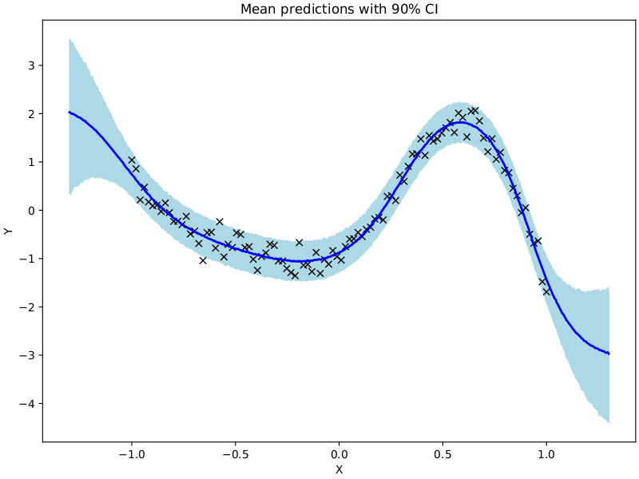
Example Result of Bayesian Neural Net
: samples
prediction
ground truth

Slide 10
Convolutional Neural Network (CNN) for Images Only?

Slide 11
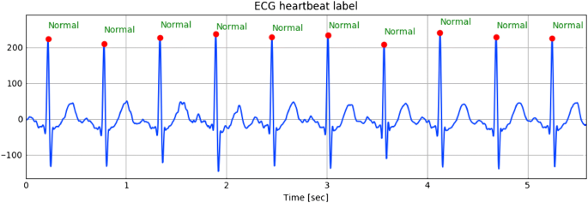
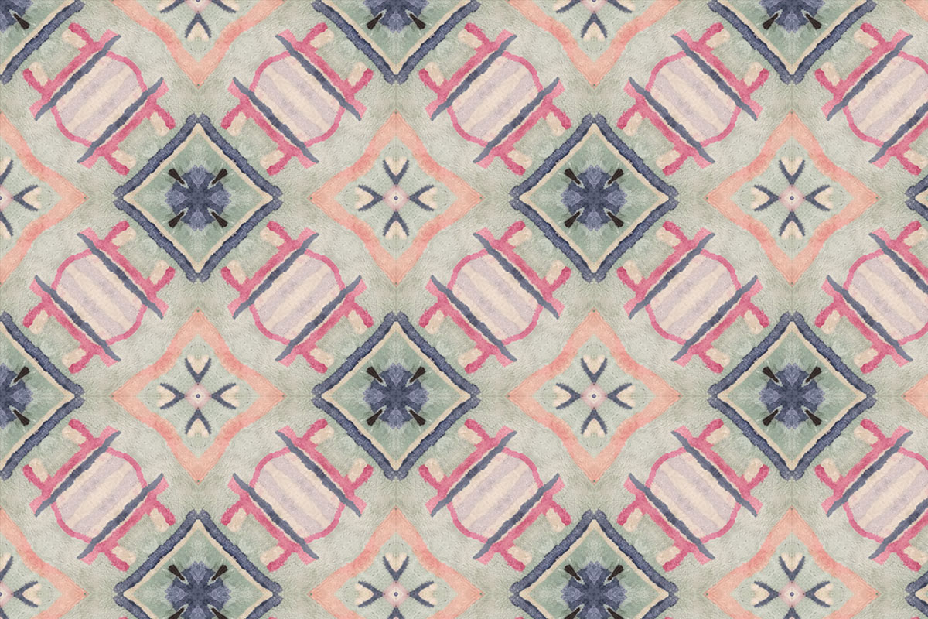
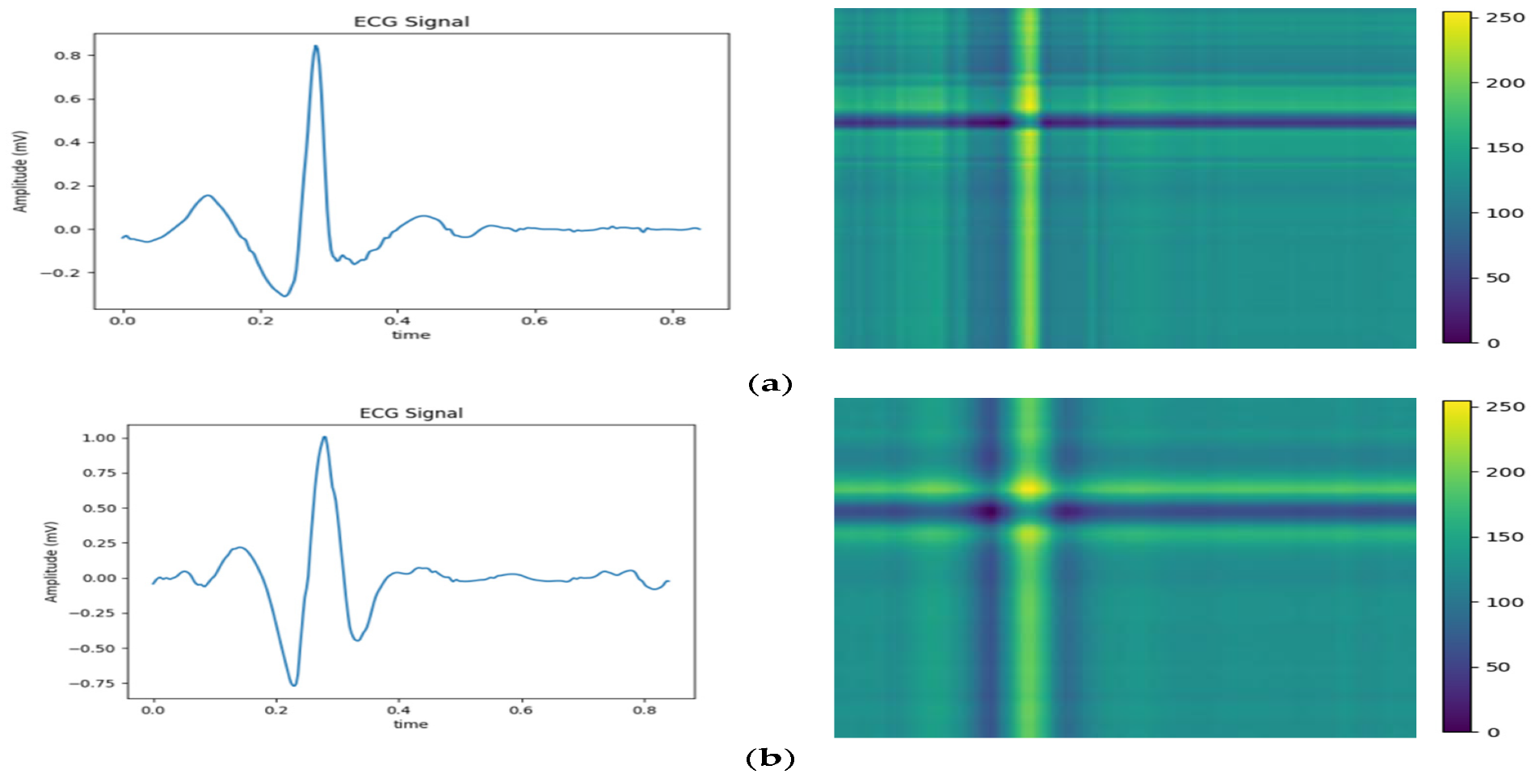
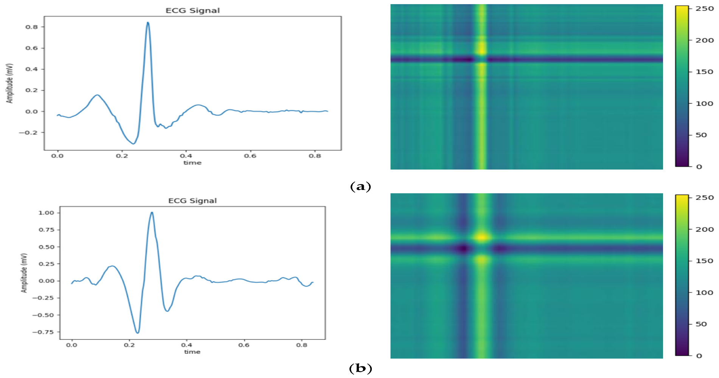
Convolutional Neural Network (CNN) for Images Only?
The answer is No
2D image
1D image

Slide 12
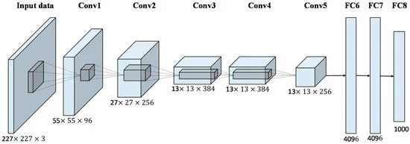

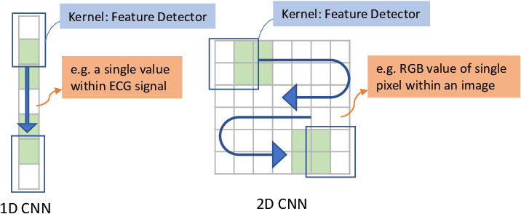
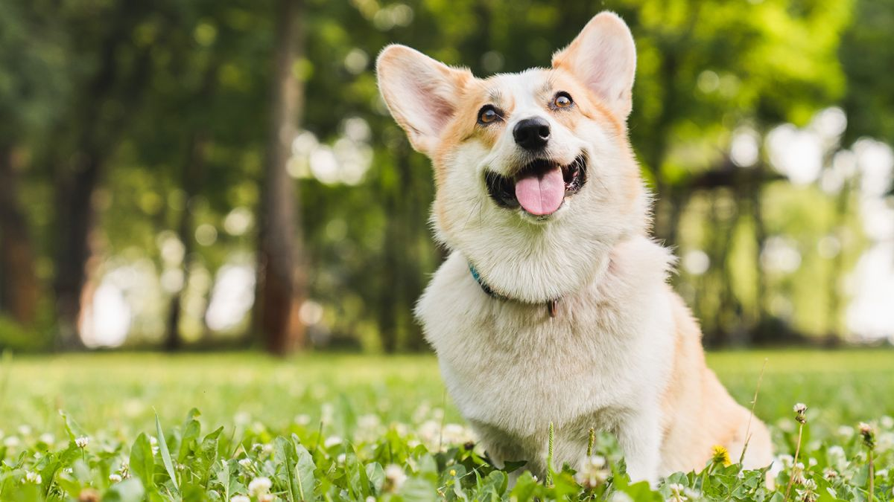
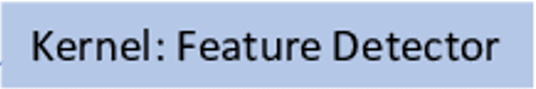
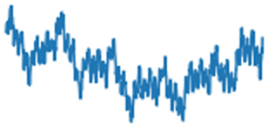
Convolutional Neural Network (CNN) for Images Only?
CNN for Time Series Processing
2D convolutional layer
1D convolutional layer
input
Conv: Convolutional layer
FC: Fully-Connected layer
#classes
Height x width x channels
input
256 x 1
64 x 32
32 x 64
16 x 128
Length x channels
#classes

Slide 13
Convolutional Neural Network (CNN) for Images Only?
Popularity of using CNN for time series processing
So popular that CNN is dominantly used for this task in the literature.

Slide 14
Goodbye Recurrent Neural Network (RNN) for Sequence Modeling

Slide 15
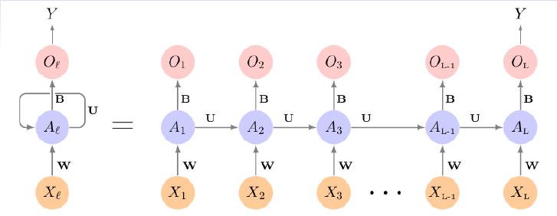
Goodbye Recurrent Neural Network (RNN) for Sequence Modeling
RNN

Slide 16
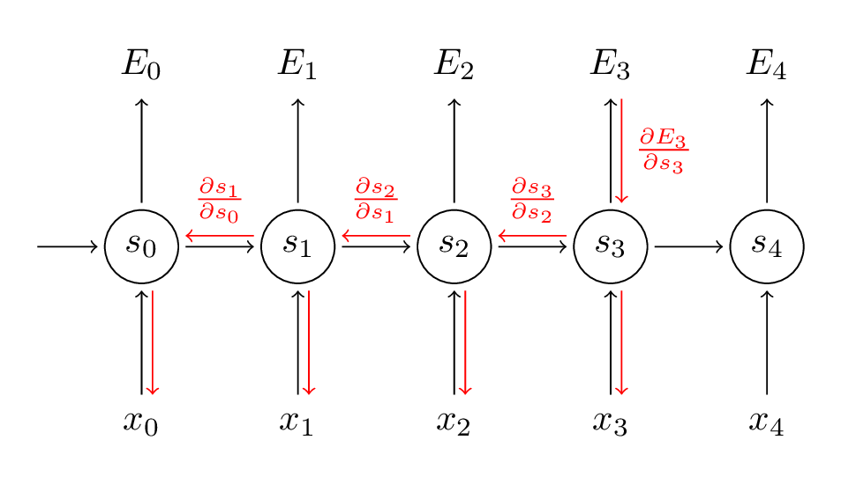

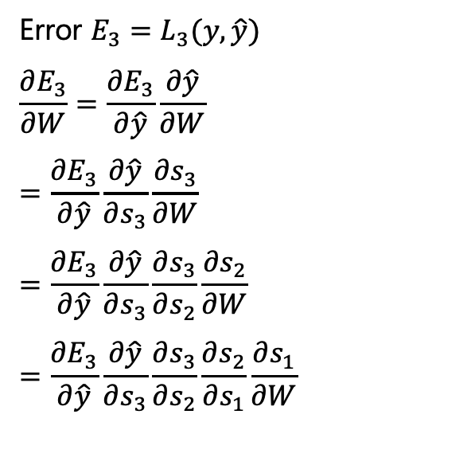



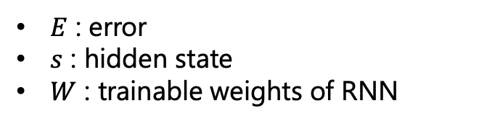

Goodbye Recurrent Neural Network (RNN) for Sequence Modeling
Limitations of RNN (1)
Error $E_{3}=L_{3}(y,\hat{y})$
$$\frac{∂E_{3}}{∂W}=\frac{∂E_{3}}{∂\hat{y}}\frac{∂\hat{y}}{∂W}$$
$$=\frac{∂E_{3}}{∂\hat{y}}\frac{∂\hat{y}}{∂s_{3}}\frac{∂s_{3}}{∂W}$$
$$=\frac{∂E_{3}}{∂\hat{y}}\frac{∂\hat{y}}{∂s_{3}}\frac{∂s_{3}}{∂s_{2}}\frac{∂s_{2}}{∂W}$$
$$=\frac{∂E_{3}}{∂\hat{y}}\frac{∂\hat{y}}{∂s_{3}}\frac{∂s_{3}}{∂s_{2}}\frac{∂s_{2}}{∂s_{1}}\frac{∂s_{1}}{∂W}$$
$$W$$
$$W$$
$$W$$
$E$ : error
$s$ : hidden state
$W$ : trainable weights of RNN
https://www.analyticsvidhya.com/blog/2021/07/lets-understand-the-problems-with-recurrent-neural-networks/

Slide 17
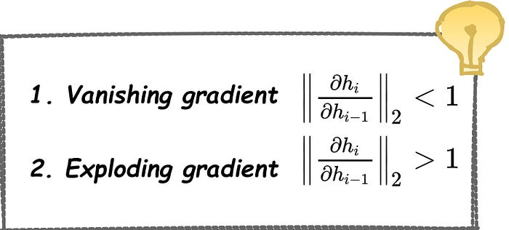
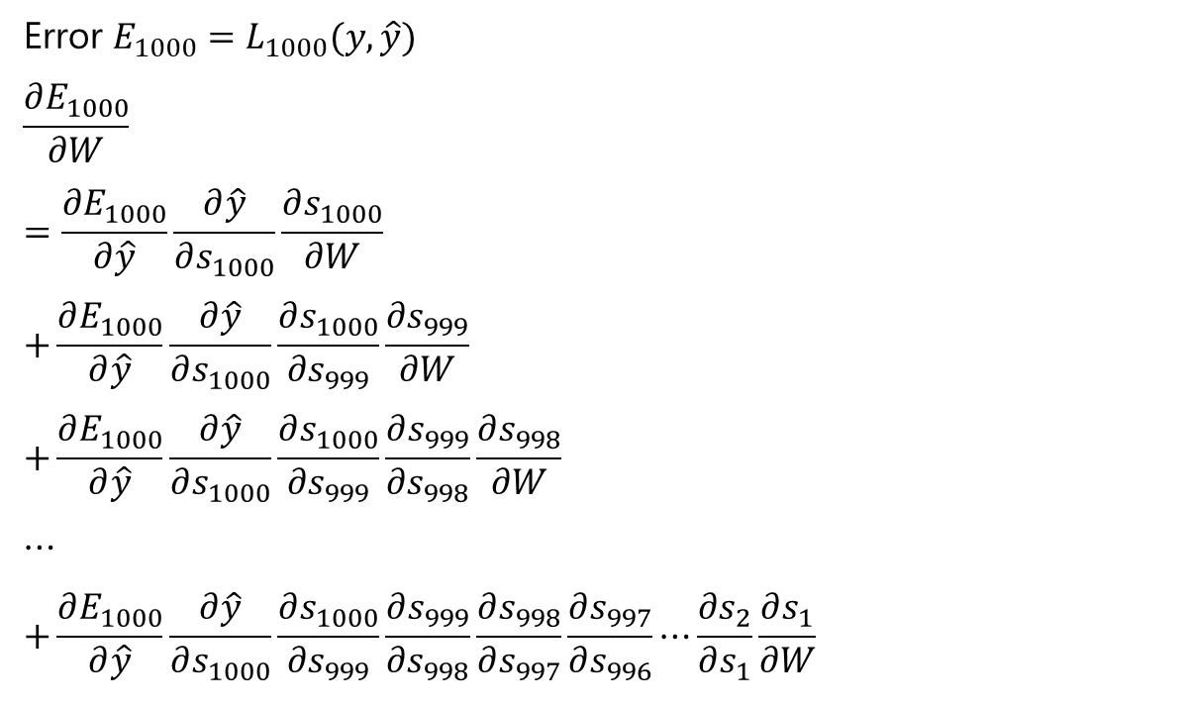
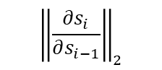
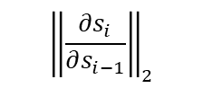
Goodbye Recurrent Neural Network (RNN) for Sequence Modeling
Limitations of RNN (1)
Error $E_{1000}=L_{1000}(y,\hat{y})$
$$\frac{∂E_{1000}}{∂W}$$
$$=\frac{∂E_{1000}}{∂\hat{y}}\frac{∂\hat{y}}{∂s_{1000}}\frac{∂s_{1000}}{∂W}$$
$$+\frac{∂E_{1000}}{∂\hat{y}}\frac{∂\hat{y}}{∂s_{1000}}\frac{∂s_{1000}}{∂s_{999}}\frac{∂s_{999}}{∂W}$$
$$+\frac{∂E_{1000}}{∂\hat{y}}\frac{∂\hat{y}}{∂s_{1000}}\frac{∂s_{1000}}{∂s_{999}}\frac{∂s_{999}}{∂s_{998}}\frac{∂s_{998}}{∂W}$$
$$⋯$$
$$+\frac{∂E_{1000}}{∂\hat{y}}\frac{∂\hat{y}}{∂s_{1000}}\frac{∂s_{1000}}{∂s_{999}}\frac{∂s_{999}}{∂s_{998}}\frac{∂s_{998}}{∂s_{997}}\frac{∂s_{997}}{∂s_{996}}⋯\frac{∂s_{2}}{∂s_{1}}\frac{∂s_{1}}{∂W}$$
$${\left\|\frac{∂s_{i}}{∂s_{i−1}}\right\|}_{2}$$
$${\left\|\frac{∂s_{i}}{∂s_{i−1}}\right\|}_{2}$$
https://www.analyticsvidhya.com/blog/2021/07/lets-understand-the-problems-with-recurrent-neural-networks/

Slide 18
Goodbye Recurrent Neural Network (RNN) for Sequence Modeling
Limitations of RNN (2)
Slow training due to the difficulty with parallel computing.
in
hidden
out
out
hidden
in
Feedforward network
RNN

Slide 19
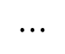
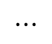
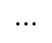
Goodbye Recurrent Neural Network (RNN) for Sequence Modeling
Limitations of RNN (3)
Difficulty with processing long sequences (i.e., the model forgets memories long in the past.)
$$⋯$$
$$⋯$$
$$⋯$$
Early signals gets weak as the processing step goes on.

Slide 20
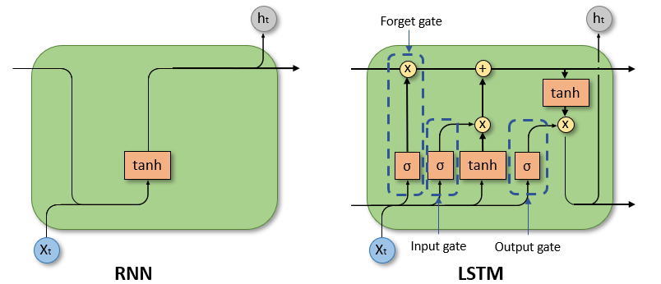
Goodbye Recurrent Neural Network (RNN) for Sequence Modeling
Long Short Term Memory (LSTM)
To resolve the forgetting problem to some extent.

Slide 21
Transformer, the replacement of RNNs

Slide 22
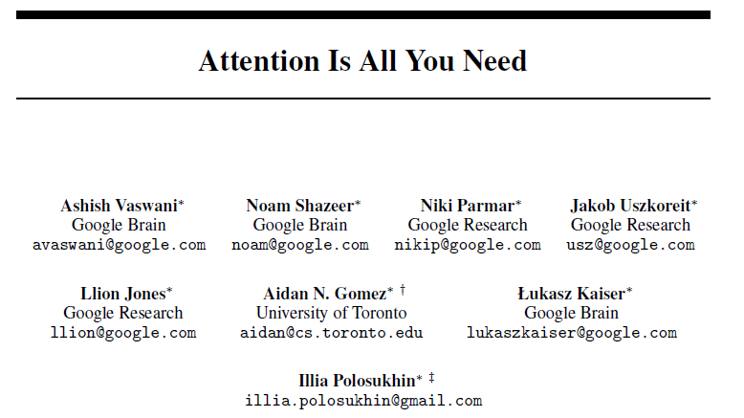
Transformer, the replacement of RNNs
A new architecture that revolutionized sequence modeling in Deep Learning
introduces Transformer
GPT = Transformer layers
Transformer over RNNs
GPT: Generative Pre-trained Transformer.

Slide 23
Transformer, the replacement of RNNs
Essence of Transformer: “Attention Layer”: 1) Self-Attention
The animal didn’t cross the street because it was too tired.
the
(sort of) correlation matrix between the same sentences.
animal
didn’t
cross
the
street
because
it
was
too
tired
animal
street
the
didn’t
cross
the
was
tired
it
too
because

Slide 24
Transformer, the replacement of RNNs
Essence of Transformer: “Attention Layer”: 1) Self-Attention
The animal didn’t cross the street because it was too tired.
the
(sort of) correlation matrix between the same sentences.
animal
didn’t
cross
the
street
because
it
was
too
tired
animal
street
the
didn’t
cross
the
was
tired
it
too
because

Slide 25

Transformer, the replacement of RNNs
Essence of Transformer: “Attention Layer”: 1) Self-Attention
The animal didn’t cross the street because it was too tired.
the
(sort of) correlation matrix between the same sentences.
animal
didn’t
cross
the
street
because
it
was
too
tired
animal
street
the
didn’t
cross
the
was
tired
it
too
because

Slide 26
Transformer, the replacement of RNNs
Essence of Transformer: “Attention Layer”: 2) Cross-Attention
My name is Daesoo ⬄ Jeg heter Daesoo
My
name
used for machine translation (e.g., google translator)
is
Daesoo
heter
Jeg
Daesoo

Slide 27
Transformer, the replacement of RNNs
RNNs vs Transformer
RNN
Transformer (block)
 | RNN | Transformer
Parallel computing | x | o
Vanishing gradient | o | x
Forgetting problem | o | x

Slide 28
Transformer, the replacement of RNNs
Transformer in use in real life
Google translator
ChatGPT
DALL-E

Slide 29
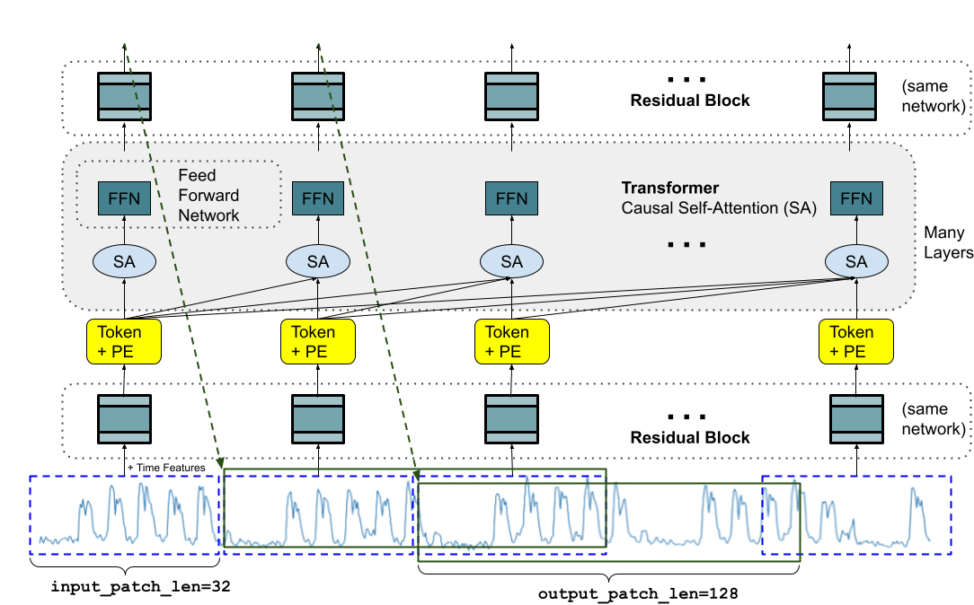

Transformer, the replacement of RNNs
Transformers for Time Series Forecasting
SA:
Self-Attention Layer
Das, Abhimanyu, et al. "A decoder-only foundation model for time-series forecasting." arXiv preprint arXiv:2310.10688 (2023). Google Research

Slide 30
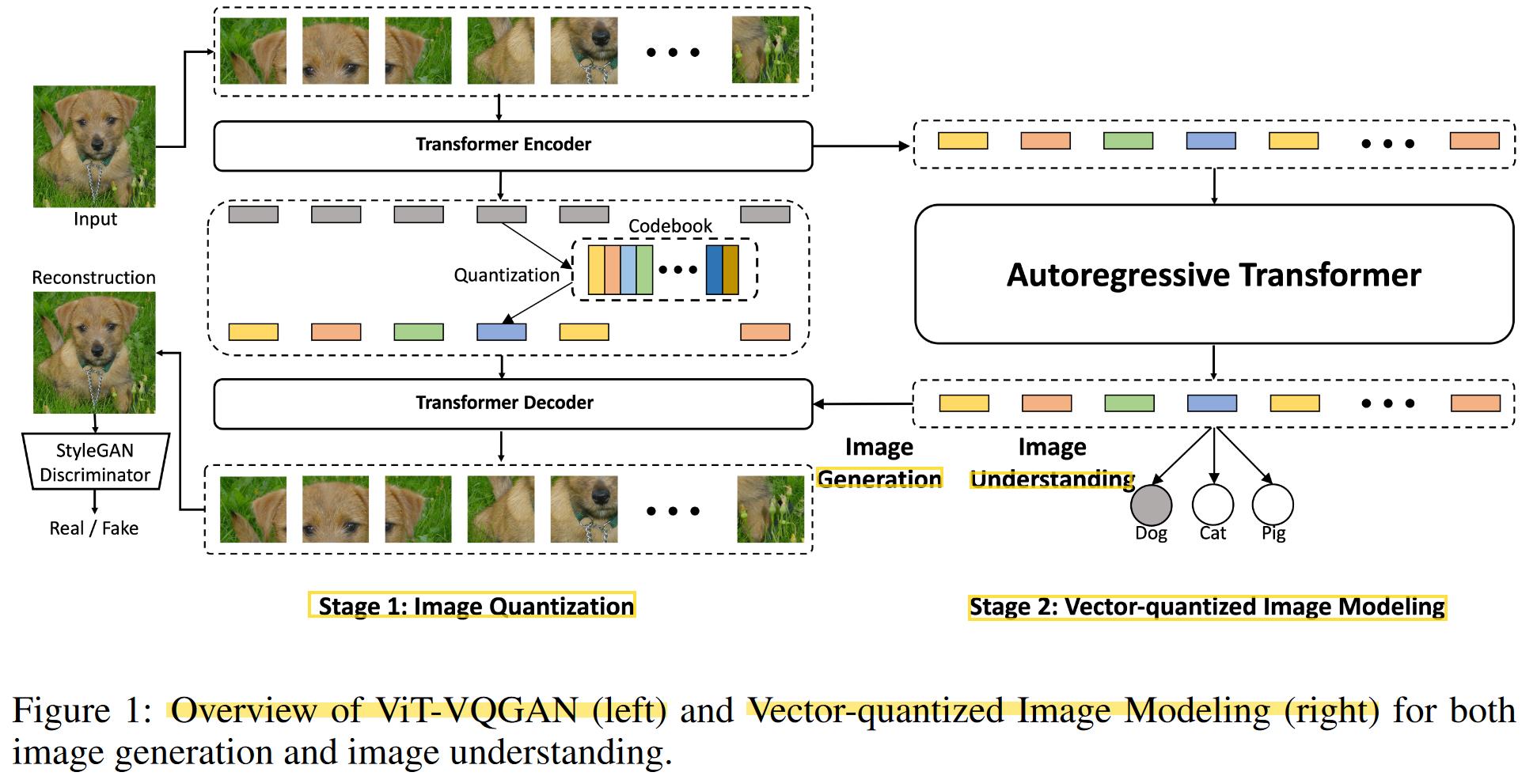


Transformer, the replacement of RNNs
Transformers for Image Modeling
treat the image as a sequence of 9.

Slide 31
Active Study Fields in Deep Learning

Slide 32
Active Study Fields in Deep Learning
Generative Models
Self-supervised Learning
Explainable AI

Slide 33
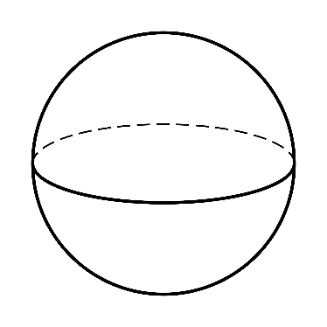
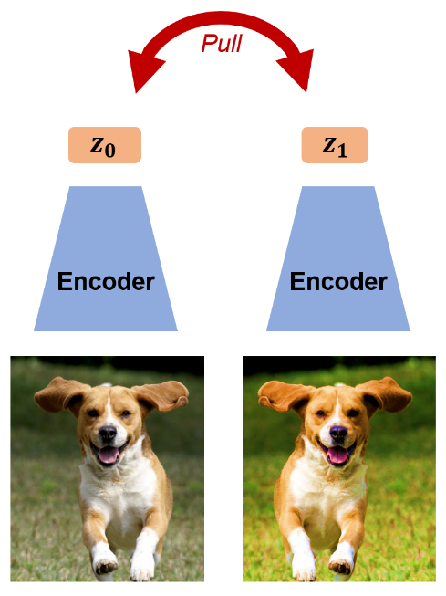
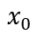
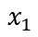
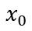
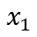
Active Study Fields in Deep Learning
Motivation for Self-supervised Learning
far apart
$$x_{0}$$
$$x_{1}$$
pixel space
$$x_{0}$$
$$x_{1}$$

Slide 34
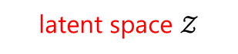
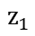
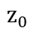
Active Study Fields in Deep Learning
Motivation for Self-supervised Learning
far apart
$$x_{0}$$
$$x_{1}$$
pixel space
$$z_{0}$$
$$z_{1}$$
$$x_{0}$$
$$x_{1}$$
latent space $𝒵$
high-level semantics (e.g., cat, dog, person) are captured

Slide 35

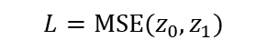
Active Study Fields in Deep Learning
Self-supervised Learning
$$L=MSE(z_{0},z_{1})$$
far apart
$$x_{0}$$
$$x_{1}$$
pixel space
$$z_{0}$$
$$z_{1}$$
$$x_{0}$$
$$x_{1}$$
latent space $𝒵$
high-level semantics (e.g., cat, dog, person) are captured in $𝒵$.

Slide 36
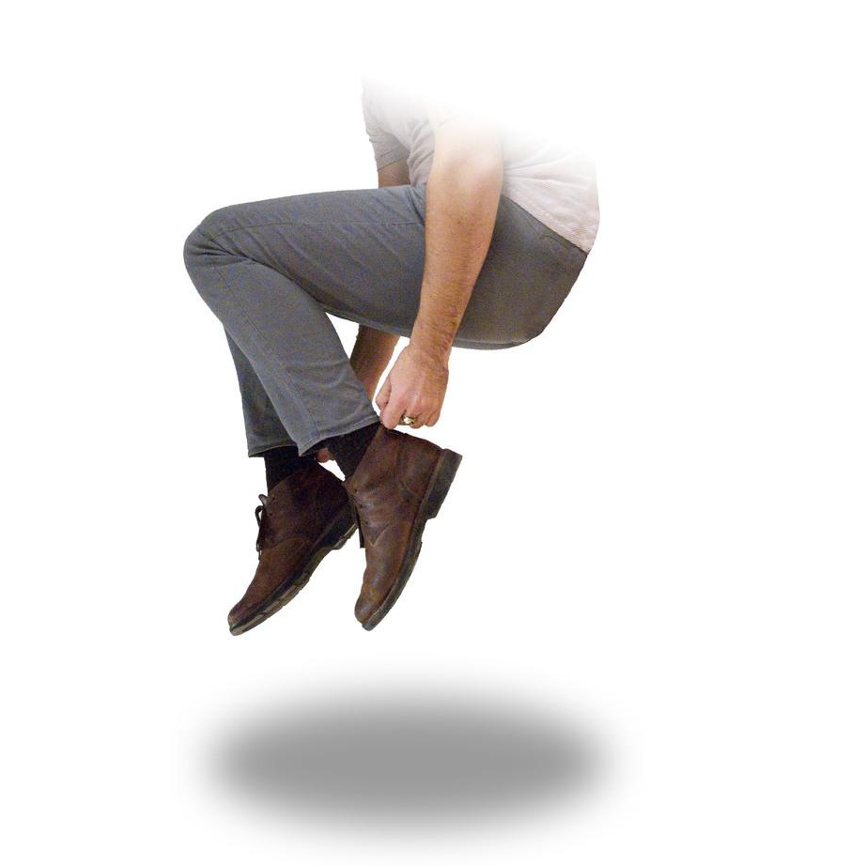
Active Study Fields in Deep Learning
Self-supervised Learning
$$L=MSE(z_{0},z_{1})$$
Q. any similarity to the concept of the bootstrapping in statistics?

Slide 37
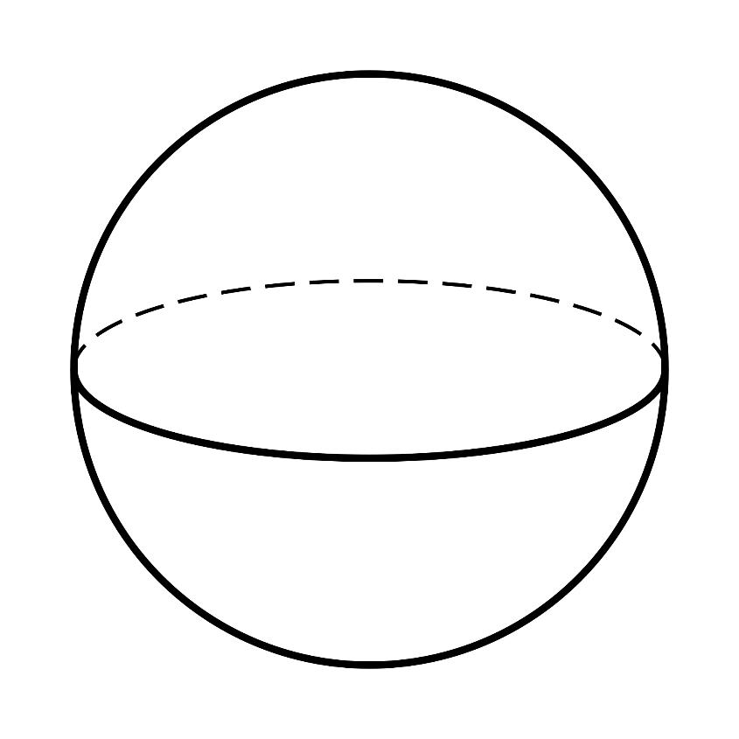


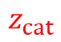
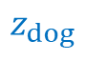
Active Study Fields in Deep Learning
Self-supervised Learning
$$L=MSE(z_{0},z_{1})$$
$$z_{dog}$$
$$z_{cat}$$
$$z_{car}$$
$$z_{tree}$$
Eventually, a neural network model
learns high-level visual concepts.
then, any task becomes easy.

Slide 38
Explainable AI

Slide 39
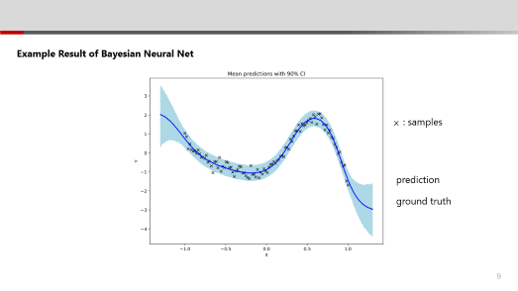
Explainable AI
We have already learned some of it

Slide 40
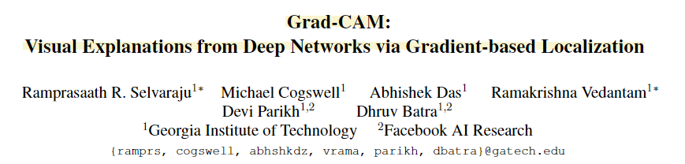
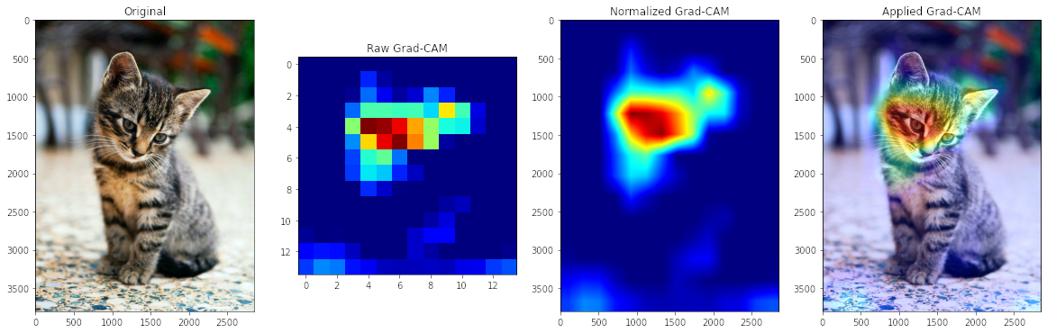

Explainable AI
Cited by 13,812
“OK, now my classification model works well.
But it’d be nicer if the model also tells me why it classified the image as that.”

Slide 41
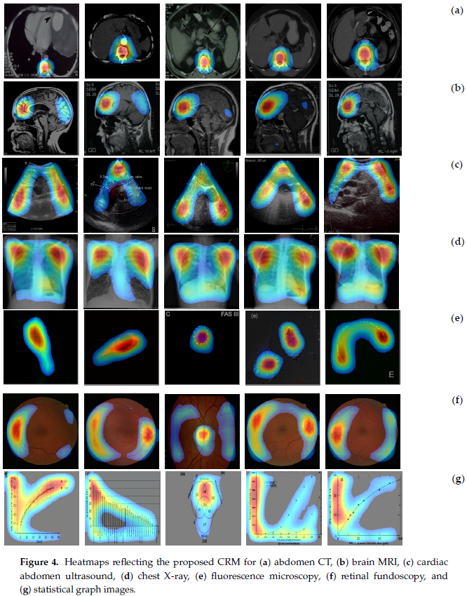
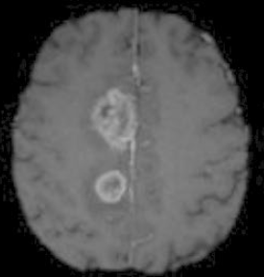

Explainable AI
Reasoning behind Classification
Brain tumor identification & detection
On the various medical images

Slide 42

Explainable AI
Counterfactual Sampling in Time Series Anomaly Detection
anomaly score
counterfactual sampling
Lee, Daesoo, Sara Malacarne, and Erlend Aune. "Explainable Anomaly Detection using Masked Latent Generative Modeling." arXiv preprint arXiv:2311.12550 (2023).

